Slide 1
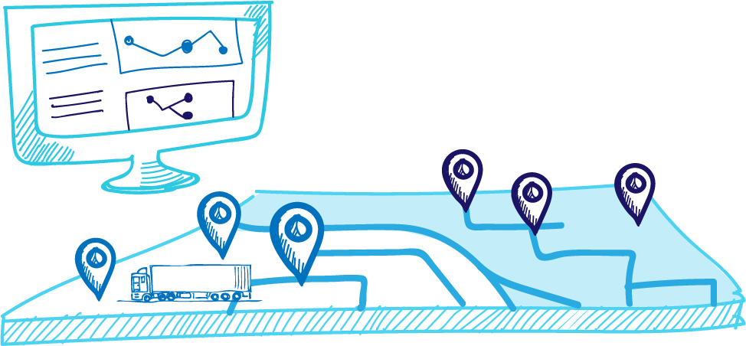
Travel Time Optimization using Machine Learning
Project Proposal : Optimization Algorithms and Techniques
Faculty: Kapil Ahuja
Submitted By:
Vikash Kumar - 170001054
Vikram Kushwaha - 170001055

Slide 2
OBJECTIVE
Our goal is to use the power of machine learning to forecast the travel time between every location and use genetic algorithm for optimization purpose to predict the best travel route .

Slide 3
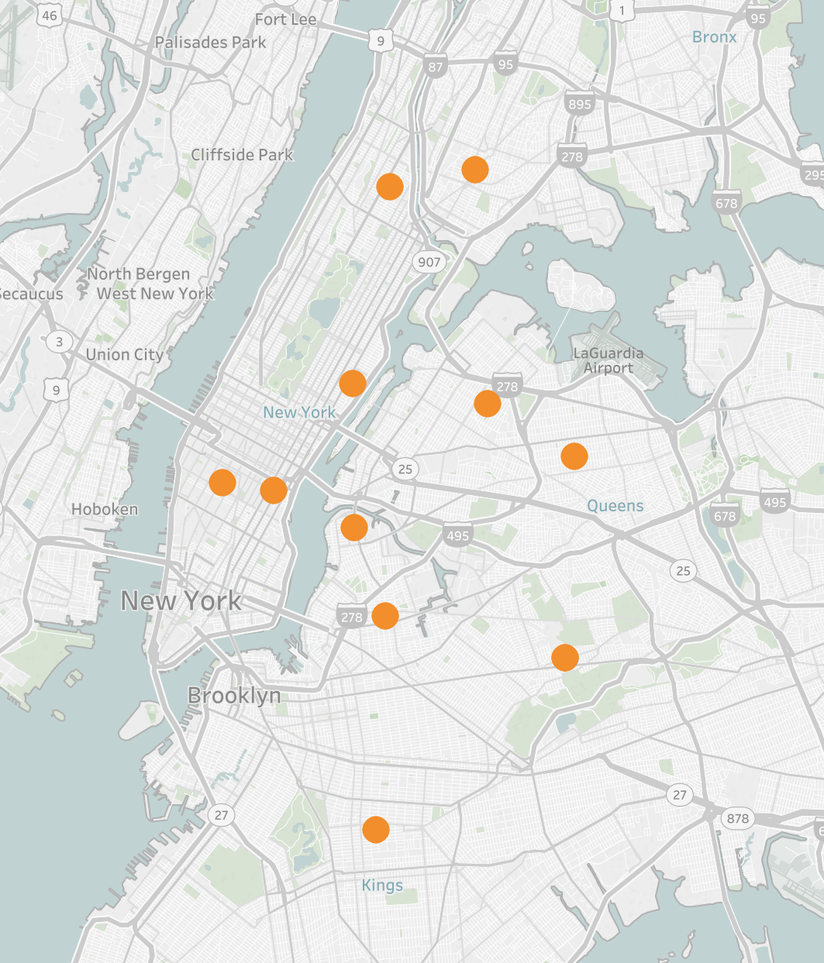
Overview:
There are given set of point on the map. We have to find the best route between them, but we do not know distance between given set of geo-spatial locations.
We would first calculate approximate distance between given set of locations using machine learning model such as XGBoost.
We will use the output from the machine learning model to find the best route among all possible. This optimization process is done using ”genetic algorithm”. The genetic algorithm is a method for solving both constrained and unconstrained optimization problems that is based on natural selection, the process that drives biological evolution.

Slide 4
Reference:
XGBoost: A Scalable Tree Boosting System- Tianqi Chen, Carlos Guestrin
XGBoost Wikipedia: https://en.wikipedia.org/wiki/XGBoost
Genetic Algorithm Wikipedia: https://en.wikipedia.org/wiki/Genetic_algorithm
A High-Performance Genetic Algorithm: Using Traveling Salesman Problem as a Case- Chun-Wei Tsai, Shih-Pang Tseng, Ming-Chao Chiang, Chu-Sing Yang, and Tzung-Pei Hong
Genetic Algorithm for Optimizing Routing Design and Fleet Allocation of Freeway Service Overlapping Patrol – Xiuqiao Sun, Jian Wang, Weitiao Wu and Wenjia Liu

